Slide 1
– Senior Design –
Online Processing for Molten Salt Reactors
– Week 5 –
David Barnett, davidbb2
Nathan Glaser, nglaser3
Joseph Specht, jspecht3

Slide 2
Goals from last Week
Understand Thermal limitations on MSBR
Determine Actinide separation method
Rough estimate on per-pass source rate
General design for fuel processing leg
Notes:
Joseph

Slide 3
Accomplished
Understand Thermal limitations on MSBR (Hastelloy-N)
Investigated Actinide removal system (PyroProcessing)
Investigated corrosion resistant piping and regulatory constraints
Progress toward
estimate on per-pass source rate
estimate on per-pass sink rate
Rough design of removal system
Fixed (hopefully) github access… (we will see)
Notes:
Joseph

Slide 4
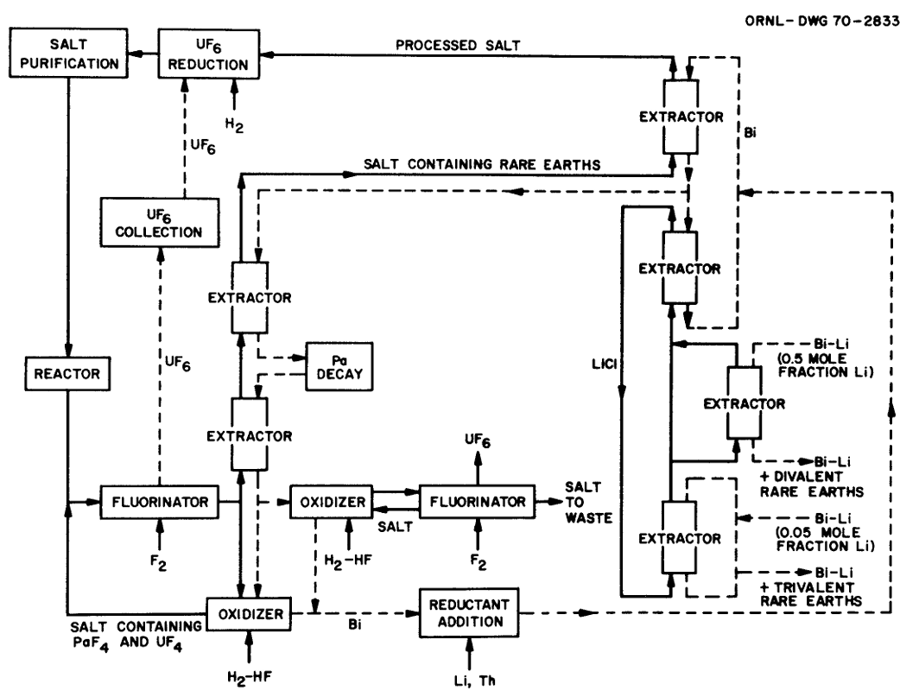
New To-Do
Further investigation of PyroProcessing for an online system (actinide removal)
Finish source and sink rates for concentrations
Finalize design of processing system
Work in actinide removal
MSBR Chemical Processing Flowsheet [2]
Notes:
Nathan

Slide 5
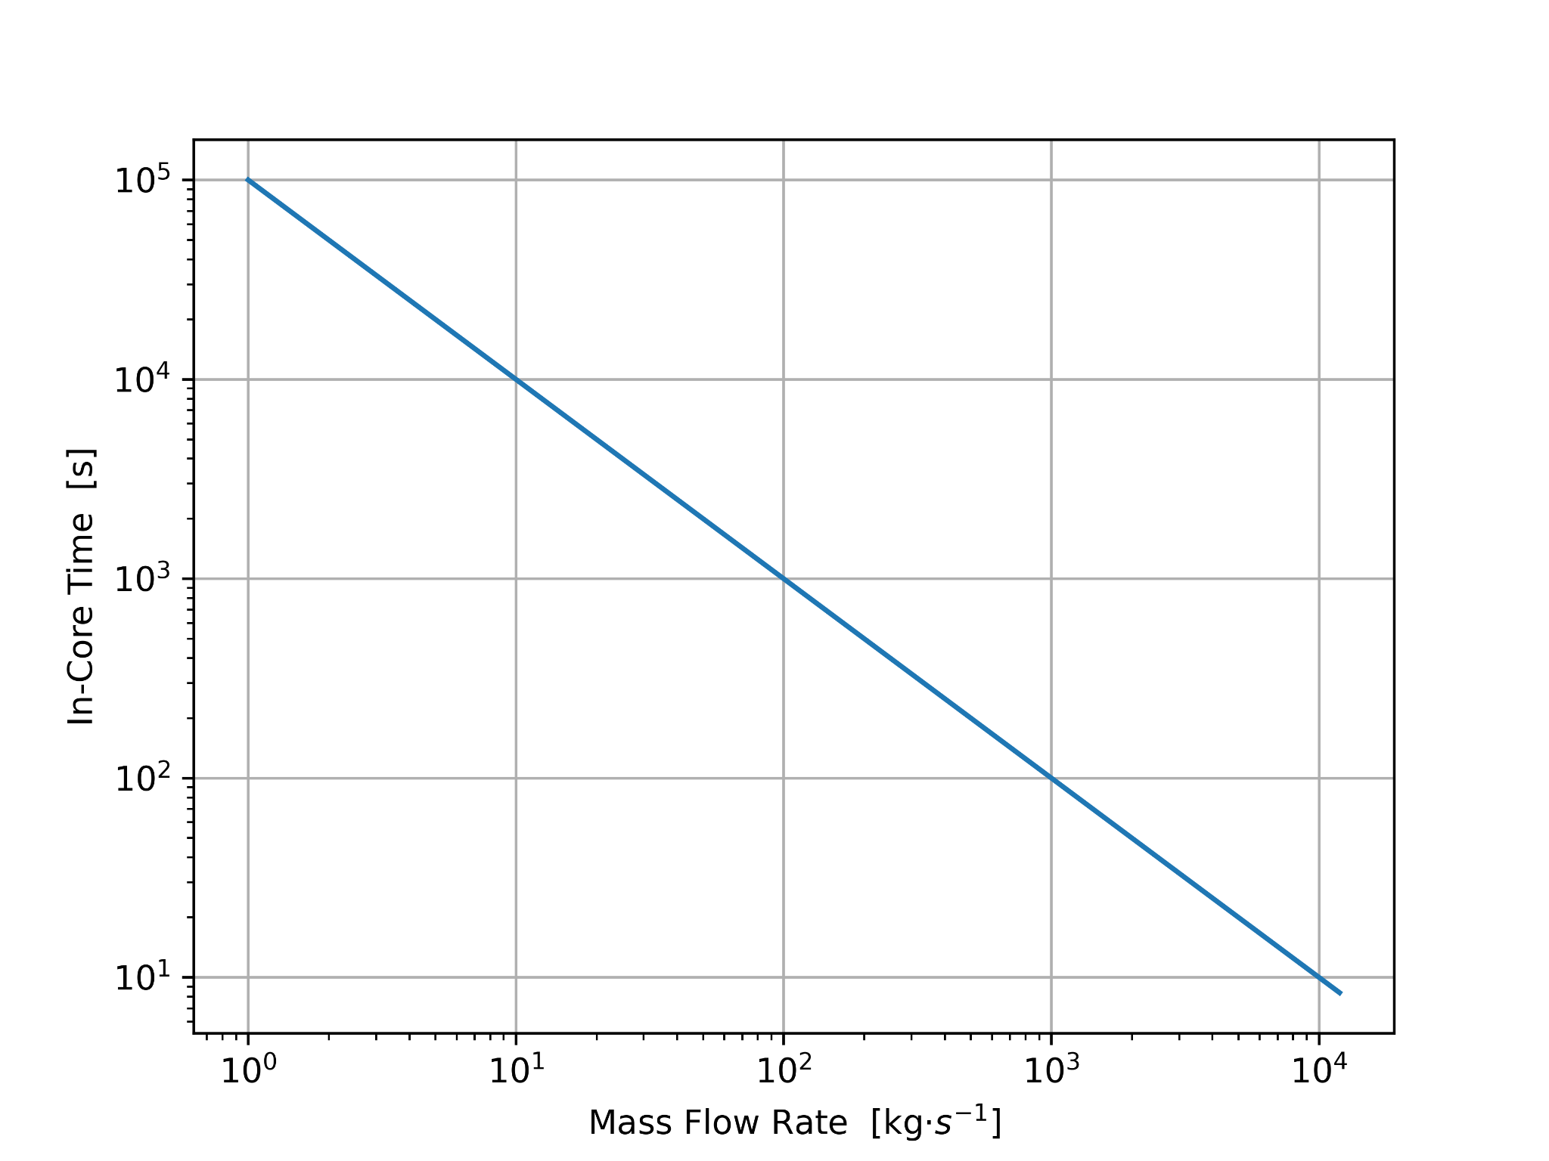
Half-D Model
Found 1G-MGXS
Fission : 0.00538 cm⁻¹
Flux : 1.379 e+14
In-core residency
Notes:
Nathan

Slide 6
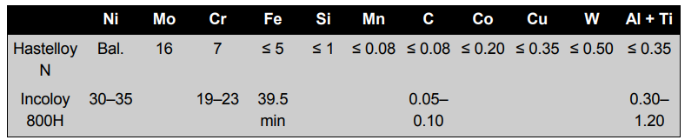
Piping
Hastelloy-N will work.
Regulated to 704C bu NRC but certified to work till temps of 871C by nrc
Neutron resistance of up to 1 dpa (full embrittlement at 2-3 dpa)
Increase of temp after heat exchanger may reduce thermal effectiveness but will likely not pose safety concerns.
Low cost and weldable.
Notes:
David

Slide 7
PyroProcessing
major difficulties in implementing an online variant.
“A theory of pyrochemical processes-is far from being complete… The time scale needed to attain the equilibrium is not known” [1]
implementation is possible within the slowed flow.
if possible, most actinides will be easily removed.
Notes:
David

Slide 8
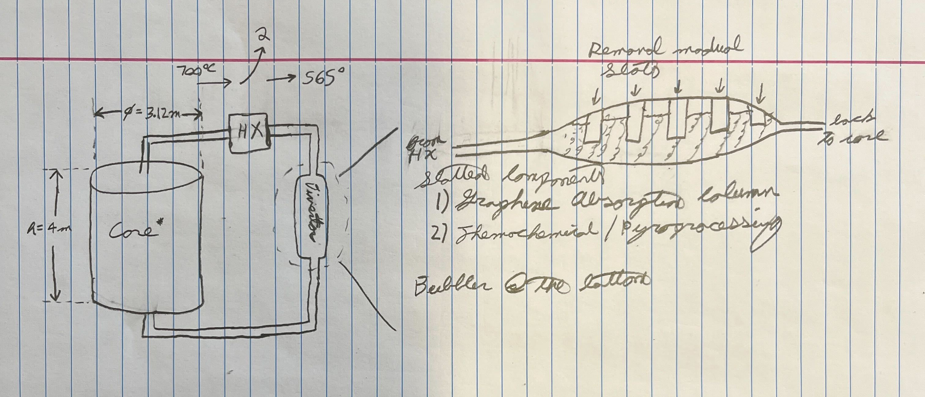
Preliminary Layout
Notes:
Joseph

Slide 9



Project Github
Notes:
Nathan

Slide 10
References
[1] Open Problems in Reprocessing of a Molten Salt Reactor Fuel., www.osti.gov/etdeweb/servlets/purl/20221908. Accessed 19 Feb. 2025
[2] Bettis, E. ORNL-TM-3832.PDF, 27 June 1972, moltensalt.org/references/static/downloads/pdf/ORNL-TM-3832.pdf.
.

